Slide 1


Han Hung
25 October 2023

Slide 2

Outline
Executive Summary
Introduction
Methodology
Results
Conclusion
Appendix

Slide 3
Executive Summary
Several methodologies will be used to collect data like REST APIs and webscraping. After the data has been collected, data wrangling and analysis, or EDA, will be employed to prepare the data for use by the machine learning algorithms. Plots, bar charts, interactive maps, and a dashboard will be built to help find patterns and trends. And finally, several machine learning algorithms will be used to analyze the data and their accuracy scores compared to determine the best method to use.
The data needed are publicly available via SpaceX’s REST APIs as well as their Wiki page. EDA was performed and data visualization was done on the results. Kennedy Space Center, or KSC, was identified as the best launch site, and several orbit types were identified as having the best launch outcomes. After training several models using different algorithms, the Decision Tree method performed the best with an 87.5% accuracy.

Slide 4


Introduction
Billionaire Allon Mask wants to start a new company, Space Y, to compete with Space X.
The goal of this project is to determine if the first stage of the rocket will land successfully or not. If the first stage can be recovered, it can be reused. Space Y can save money and charge less per flight.
Currently, Space X charges $62 million per launch. This is because they can land the first stage and reuse it for another mission. Competitors charge $165 million or more for a similar mission because their stages are single use.
To further this goal, a model will be built using Machine Learning to predict if the first stage can be recovered or not.
Another goal is to identify the best site to launch flights.

Slide 5

Section 1

Slide 6
Methodology
Data collection methodology:
Retrieve data from SpaceX server using their public REST APIs.
Retrieve data from their Wiki page.
Perform data wrangling
Categorical values were converted to numeric.
Null values were transmuted.
Irrelevant columns were dropped.
Perform exploratory data analysis (EDA) using visualization and SQL:
Scatter plots, bar charts, and a line plot were created to show patterns and trends.
SQL queries were used to extract data for analysis.
Perform interactive visual analytics using Folium and Plotly Dash
An interactive dashboard was created to show launch outcomes by launch site.
Folium maps were created to show locations of launch sites as well as launch outcomes and distances to nearest public landmarks.
Perform predictive analysis using classification models
Several models were built using different algorithms.
Their accuracy was computed and compared and the one with the best accuracy score was chosen.

Slide 7
Data Collection
The data sets needed for this project reside in a few places. SpaceX has a public REST API server that contains many data. Their Wiki page also contains useful data for this project.
The data was collected using a combination of REST API calls to SpaceX, as well as scraping the data from their Wiki page.
The general flow for data collection is on the right.
Retrieve data from SpaceX REST APIs or scraped from their Wiki page
Dataframe created from collected data
Data cleaned and filtered as needed
Data saved to a CSV file

Slide 8
Data Collection – SpaceX API
To the right is a flowchart showing the steps taken to retrieve the data from SpaceX’s website.
This is a list of data retrieved:
List of past launches
Booster versions
Launch sites
Payload data
Core data like outcome, flight, reuse, etc.
The GitHub repository for the notebook can be found here.
REST API calls to SpaceX server
Data returned from SpaceX
Data saved to local dictionaries
Dictionaries converted to single data frame
Data frame saved to a CSV file
https://github.com/hhung01/data-science-capstone/blob/main/notebooks_and_data/Week_1_lab_1_jupyter-labs-spacex-data-collection-api.final.ipynb

Slide 9
Data Collection - Scraping
The records for all of SpaceX launches were located on their Wiki page.
The page was downloaded and a BeautifulSoup object was created to allow for easy navigation in Python.
Data from the relevant table was converted into a Pandas data frame.
The data was cleaned and reformatted.
Finally, the data frame was saved to a CSV file.
The GitHub repository can be found here.
Download launch records from Wiki page
Wiki page converted to BeautifulSoup object
Data extracted from table using BeautifulSoup
Data saved to a data frame
Data cleaned and reformatted
Data saved to a CSV file
https://github.com/hhung01/data-science-capstone/blob/main/notebooks_and_data/Week_1_lab_2_jupyter-labs-webscraping.final.ipynb

Slide 10
Data Wrangling
Data wrangling is about transforming the raw data into more readily usable formats. For example, converting a date and time string into an actual date and time data type, removing unnecessary columns, identifying null values and either removing them or transmuting them into something useful, converting categorical data into numerical ones, or creating new columns based on existing columns.
What was done:
Replaced null values for payload with the average, known payloads.
Create a new ‘Class’ column based on the landing outcome.
0 represents a failed landing.
1 represents a successful landing.
Once completed, the data frame was saved to a CSV file.
The GitHub repository can be found here.
Load CSV file created by previous notebook
Validate the data
Determine landing types that failed
Create new column to identify success/failed landings
Data saved to a CSV file
https://github.com/hhung01/data-science-capstone/blob/main/notebooks_and_data/Week_1_lab_3_jupyter-spacex-Data%20wrangling.final.ipynb

Slide 11
EDA with Data Visualization
Visualizing data is one of the most useful methods to understanding the data. It makes it easier to find patterns, trends, and insights from the data.
The following table shows the charts and plots that were created.
Data Displayed | Chart or Plot Type | Purpose
Flight Number vs. Payload Mass | Scatter Plot | Payload mass increased over time
Flight Number vs. Launch site | Scatter Plot | SpaceX launches from 4 different locations. This shows which launch site was used the most as well as which flights were successful or not.
Payload Mass vs. Launch Site | Scatter Plot | Shows which launch sites carried how much payload.
Class vs. Orbit Type | Cat Plot | Shows success/failure by orbit type.
Success Rate vs. Orbit Type | Bar plot | Shows which orbit type had the most successful mission outcomes.
Flight Number vs. Orbit Type | Scatter Plot | Shows which orbit type originated from which flight.
Payload mass vs. Orbit Type | Scatter Plot | Shows the payload mass for each orbit type.
Success rate by Year | Line Chart | Shows the success trend over the years.
The GitHub repository can be found here.
https://github.com/hhung01/data-science-capstone/blob/main/notebooks_and_data/Week_2_lab_2_jupyter-labs-eda-dataviz.ipynb.jupyterlite.final.ipynb

Slide 12
EDA with SQL
SQL is a useful tool because most data in the real-world are stored in databases.
The following SQL queries were performed:
Display the names of the unique launch sites
Display 5 records where the launch site begins with ‘CCA’
Display the total payload mass carried by boosters launched by NASA (CRS)
Display the average payload mass carried by booster ‘F9 v1.1’
List the date when the first successful landing on the ground pad was achieved
List the names of the boosters which have success landing on drone ships and have a payload mass greater than 4,000 but less than 6,000
List the total number of successful and failed mission outcomes
List the names of the booster versions which have carried the maximum payload mass
List the records which will display the month names, failure landing on drone ship, booster versions, and launch sites for the year 2015
Rank the count of landing outcomes between 2010-06-04 and 2017-03-20 in descending order
The GitHub repository can be found here.
https://github.com/hhung01/data-science-capstone/blob/main/notebooks_and_data/Week_2_lab_1_jupyter-labs-eda-sql-coursera_sqllite.final.ipynb

Slide 13
Build an Interactive Map with Folium
Folium makes it easy to create interactive maps in a Jupyter notebook that contain markers, lines, icons, etc. to identify points of interest.
Folium Object | Purpose
Map | This creates the map object where child objects like circles, icons, etc. can be added.
Circle | Add a highlight circle, in map units, around a specific coordinate.
Marker | Add a fixed sized marker object around a specific coordinate.
Popup | Add a popup label to an object when the user clicks on a marker.
CircleMarker | Combination of a circle and marker object.
MarkerCluster | Use this object when there are multiple objects with the same coordinates. It will display the number of items at that coordinate when zoomed out. When zoomed in, it will expand to display all the objects around that coordinate.
PolyLine | Draws a line between two or more coordinates
Icon | Draws an icon on the map at the specified coordinate.
The GitHub repository can be found here.
Note: When viewing the file in GitHub, the maps were not displayed.
https://github.com/hhung01/data-science-capstone/blob/main/notebooks_and_data/Week_3_lab_1_lab_jupyter_launch_site_location.jupyterlite.final.ipynb

Slide 14
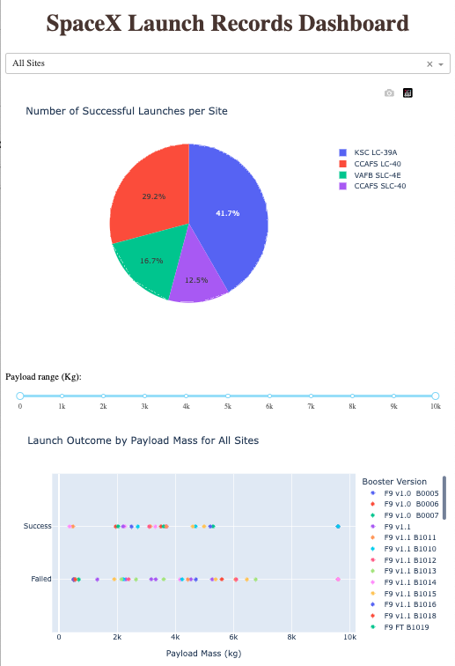
Build a Dashboard with Plotly Dash
Dashboards provide an interactive way to present the data.
Elements used in the dashboard:
Dropdown list to select which launch site to display.
Range slider to adjust payload mass to display in the scatter plot.
Pie chart showing the success to failure ratios for launch sites.
Scatter plot showing the launch outcome by payload mass for the selected site or all sites.
When ‘All’ is selected, the pie chart will display the number of successful launches at each site and the scatter plot will display which booster versions were successful or not for all sites.
If a site is selected, the pie chart will display the ratio of failed to successful launches for the selected site and the scatter plot will display which booster version was successful or not for the selected site.
The range slider is used to change the upper and lower range of payload to display in the scatter plot.
The GitHub repository can be found here.
https://github.com/hhung01/data-science-capstone/blob/main/notebooks_and_data/Week_3_lab_2_spacex_dash_app.final.py

Slide 15
Predictive Analysis (Classification)
Once all the data has been collected, the following steps were performed to find the best model:
Standardize, scale, and transform the data.
Split data into training and test sets using 80/20 split ratio.
Build different models using the training data
Determine performance for each model using the test data
Compare the accuracy scores for each model
Pick the model with the best scores.
See flow chart on the right for an overview of the model development process.
The GitHub repository can be found here.
Load data into dataframe
Standardize, scale, and transform the data
Split data into training and test sets
Build different models using training data
Determine performance using test data
Compare accuracy scores to determine best model
https://github.com/hhung01/data-science-capstone/blob/main/notebooks_and_data/Week_4_lab_1_SpaceX_Machine_Learning_Prediction_Part_5.jupyterlite.final.ipynb

Slide 16
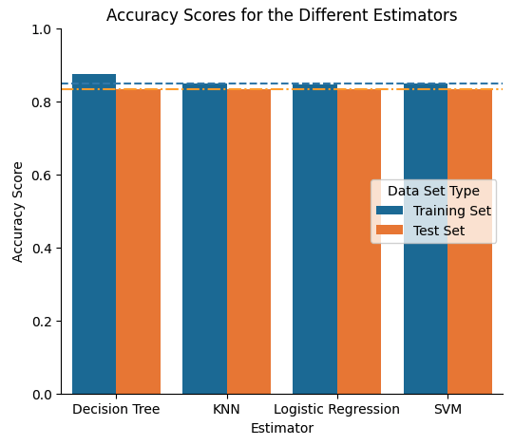
Results
The following algorithms were evaluated:
Logistic Regression (LR)
Decision Trees (DT)
Support Vector Machine (SVM)
K-Nearest Neighbor (KNN)
After evaluating the different algorithms, LR, SVM, and KNN all produced similar accuracy scores using training data.
The DT algorithm scored the best using training data.
All 4 algorithms scored the same using test data.
Because DT had the bests score, it will be used to predict the launch outcome for future flights.

Slide 17

Section 2

Slide 18
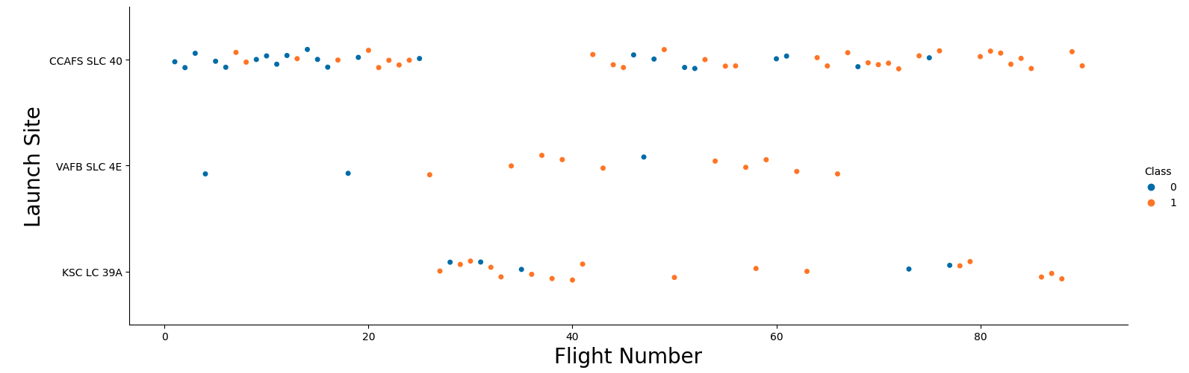
Flight Number vs. Launch Site
The blue dots are Class 0, or flights with failed outcomes.
The orange dots are Class 1, or flights with successful outcomes.
SpaceX started launching rockets from CCAFS SLC-40, with some launches from VAFB SLC-4E.
At one point, they switched to using KSC LC-39A before switching back to CCAFS SLC-40 for most of their flights.
At the beginning, most of the flights had failed outcomes. But their success rate increased over time.

Slide 19
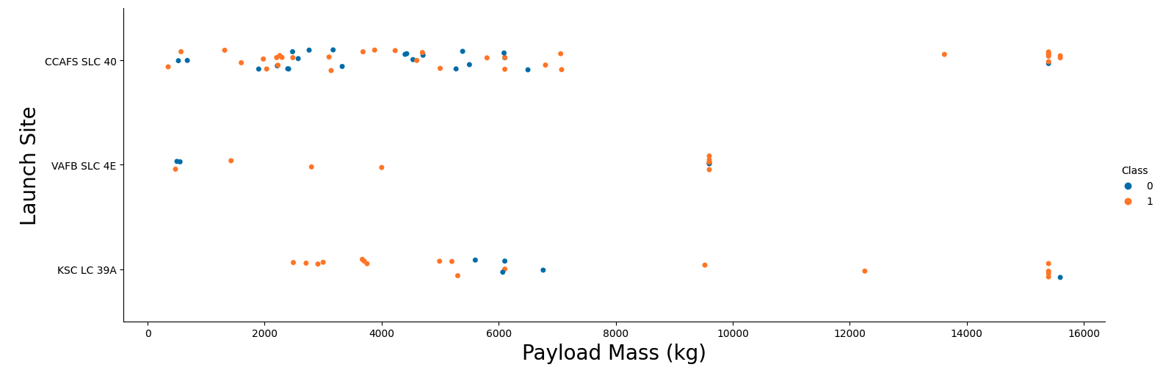
Payload vs. Launch Site
A lot of flights with payloads less than 8,000 kg originated from CCAFS SLC-40.
CCAFS SLC-40 and KSC LC-39A launched the heaviest payloads (those greater than 10,000 kg).
The heaviest payload launched from VAFB SLC-4E is around 9,600 kg.

Slide 20
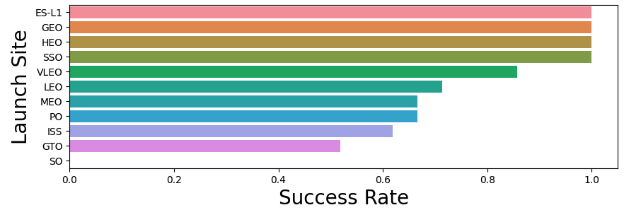
Success Rate vs. Orbit Type
The orbit types with the most successful flights were ES-L1, GEO, HEO, and SSO with a success rate of 100%.
The least successful orbit type is SO, with a success rate of 0%.

Slide 21
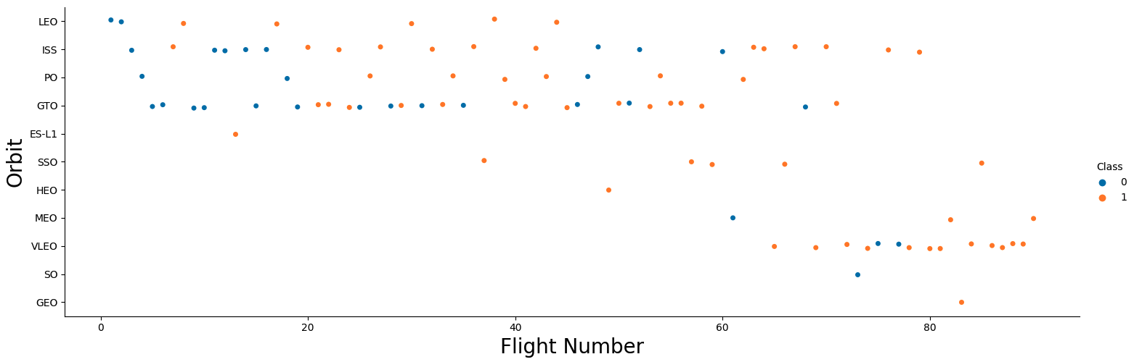
Flight Number vs. Orbit Type
At the beginning, most flights had orbit types of LEO, ISS, PO, and GTO.
Over time, other orbit types were added.
Later flights concentrated on VLEO orbit type.

Slide 22
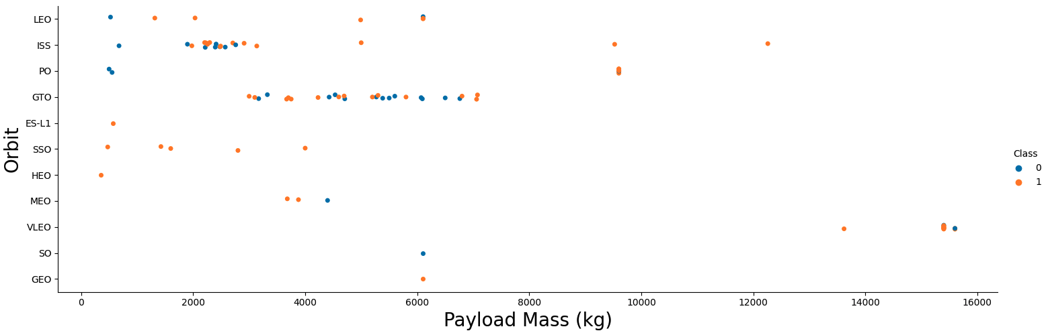
Payload vs. Orbit Type
Flights to the ISS typically carry between 2,000 to 3,000 kg per flight. Although some flights carried as much as 12,000 kg.
VLEO orbits tend to carry heavier payloads compared to LEO ones.
Payloads for GTO orbits range from around 3,000 to 7,000 kg.

Slide 23
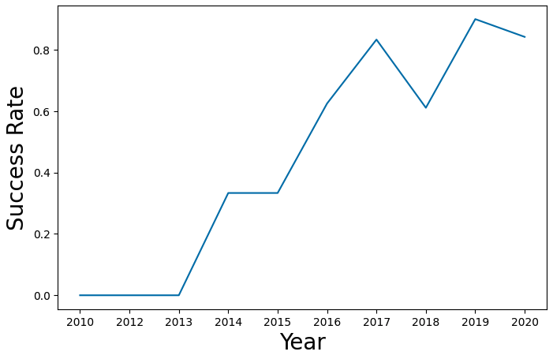
Launch Success Yearly Trend
Between 2010 and 2013, there were no successful launches.
Starting from 2013, the success rate increased on an annual basis.
There was a dip in the success rate around 2018 but recovered in 2019 and dipped again slightly in 2020.

Slide 24
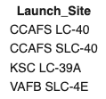
All Launch Site Names
The names of all the unique launch sites are:
CCAFS LC-40
CCAFS SLC-40
KSC LC-39A
VAFB SLC-4E
The SQL query used to retrieve this data is:
DISTINCT instructs SQL to only return unique values of Launch_Site from the table.
ORDER BY instructs SQL to order the output by Launch_Site. The default order is in ascending order.

Slide 25
Launch Site Names Begin with 'CCA'
The 5 records where the launch site begins with ‘CCA’ are:
The SQL used to retrieve this is:
LIKE combined with ‘CCA%’ tells SQL to search the column Launch_Site for values that begins with ‘CCA’.
LIMIT tells SQL to return the first 5 records it finds.

Slide 26
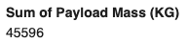
Total Payload Mass
The total payload carried by boosters from NASA is:
The SQL query used to retrieve this data is:
The SUM() function tells SQL to add up all the values in the PAYLOAD_MASS_KG_ column.
The WHERE clause tells SQL to only include rows where the Customer is ‘NASA (CRS)’

Slide 27
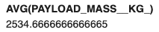
Average Payload Mass by F9 v1.1
The average payload mass carried by booster version F9 v1.1 is
The SQL query used to calculate this is:
The AVG() function tells SQL to get the average of all the values in the PAYLOAD_MASS_KG_ column.
The WHERE clause tells SQL to limit the results where the Booster_Version contains the pattern ‘%F9 v1.1%’. The ‘%’ on both sides tell the LIKE clause to match anywhere in the string.

Slide 28

First Successful Ground Landing Date
The date of the first successful landing outcome on ground pad is:
The SQL query used to determine this is:
The MIN() function is used to find the minimum value in the specified column.

Slide 29
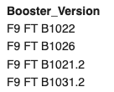
Successful Drone Ship Landing with Payload between 4000 and 6000
The names of boosters which have successfully landed on drone ship and had payload mass greater than 4000 but less than 6000 are:
The SQL query used to retrieve this data is:
The ‘\’ tells the %sql parser that it is a multi-line command.
The WHERE clause tells SQL to return records where the Landing_Outcome is equal to ‘Success (drone ship)’ and the PAYLOAD_MASS_KG_ is greater than 4,000 and less than 6,000 kg, exclusive.

Slide 30
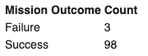
Total Number of Successful and Failure Mission Outcomes
The total number of successful and failed mission outcomes are:
The SQL query used to retrieve this information is:
The SQL query consists of 2 separate SELECT statements.
The COUNT() function tells SQL to count the number of records matching the condition in the WHERE clause.
UNION tells SQL to combine the results from the two SELECT statements into one table.

Slide 31
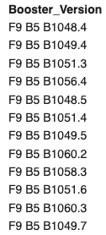
Boosters Carried Maximum Payload
The names of the booster which have carried the maximum payload mass are listed on the right.
The SQL query used to retrieve this information is:
The MAX() function was used in the subquery to retrieve the maximum payload.
A subquery was needed because of the way the SQL processor works.
This value was then used to compare against the PAYLOAD_MASS_KG_ for all records.

Slide 32
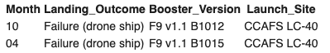
2015 Launch Records
The list of failed landing outcomes in drone ship, their booster versions, and launch site names for in year 2015 is:
The SQL query used to retrieve this information is:
The function SUBSTR(Date, 6, 2) was used to extract the month from the Date column to be returned with the results.
The function SUBSTR(Date, 0, 5) was used to extract the year from the Date column for comparison in the WHERE clause.

Slide 33
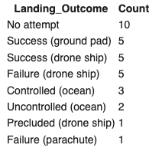
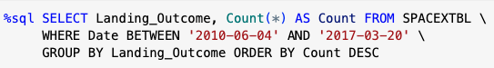
Rank Landing Outcomes Between 2010-06-04 and 2017-03-20
The count of landing outcomes between the date 2010-06-04 and 2017-03-20 is displayed to the right.
The SQL query used to retrieve this data is:
The BETWEEN in the WHERE clause tells SQL to return records between the 2 specified dates, inclusive.
GROUP BY tells SQL to group all records by Landing_Outcome.
The Count() function tells SQL to count the records grouped by Landing_Outcome.
ORDER BY tells SQL to order the results by Count in descending order.

Slide 34

Section 3

Slide 35
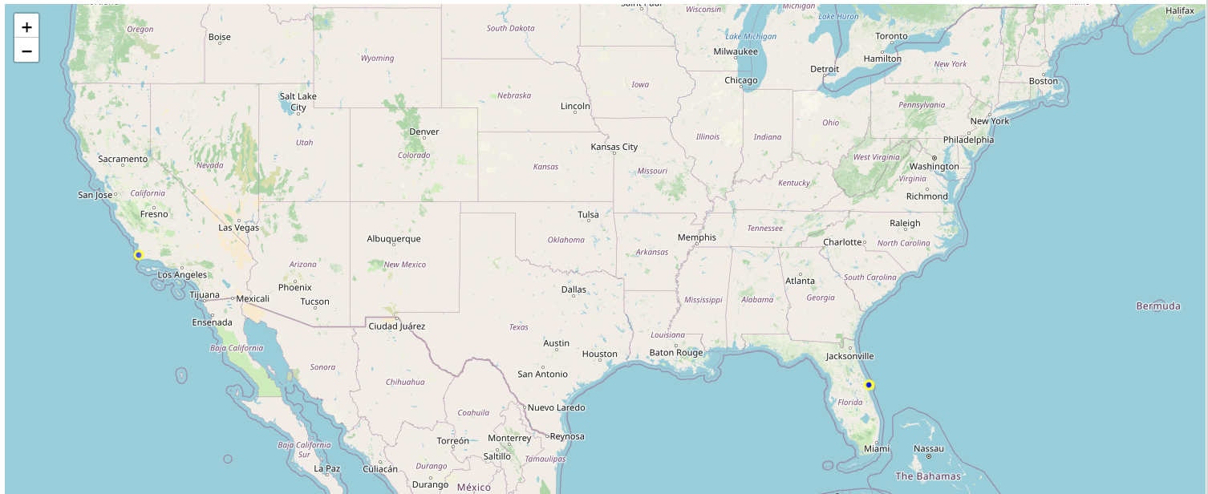
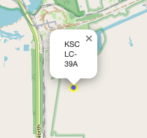
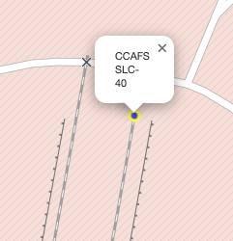
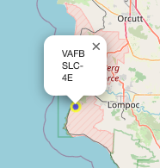
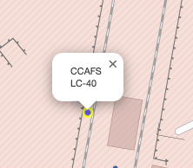
Map of All Launch Sites
SpaceX uses 4 different launch sites.
3 of the launch sites are located in Florida at the Kennedy Space Center (KSC) and Cape Canaveral (CCAFS).
Kennedy Space Center and Cape Canaveral are right next to each other on the east coast of Florida.
The one launch site in California is located at the Vandenberg Air Force Base (VAFB) Space Launch Complex (SLC).

Slide 36
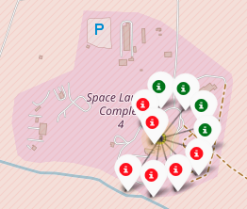
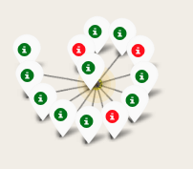
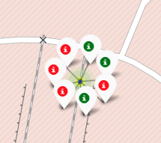
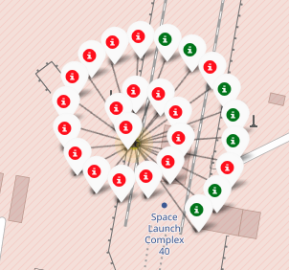
Launch Outcomes
VAFB SLC-4E
KSC LC-39A
CCAFS SLC-40
CCAFS LC-40
The images above show the launch outcomes for all the flights from each launch location.
The number of markers around each site indicates the number of launches made from that site.
A red marker indicates a failed outcome while the green marker indicates a successful outcome.
From the images above we can easily conclude the following:
CCAFS SLC-40 launched the least number of flights.
CCAFS LS-40 launched the most number of flights.
KSC LC-39A launched the most number of successful flights
CCAFS LC-40 has the most flights that failed.

Slide 37
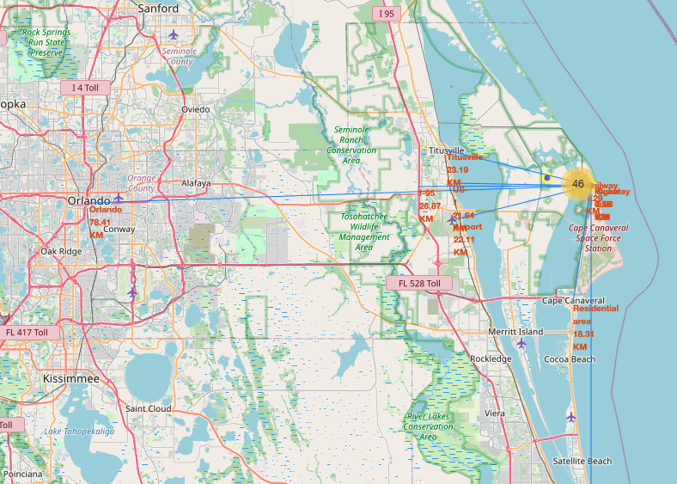
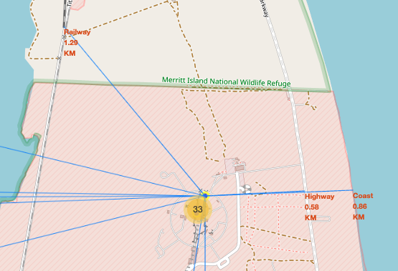
Proximity Map for CCAFS SLC-40
The image to the right is a proximity map showing distances to several points of interest like Orlando (nearest major city), nearest airport, major highways, coast, and other locations.
The lower image displays a zoomed in portion showing the 3 closest points of interest to the launch site.
The coastline and highway are less than 1 km away.
The nearest railway is about 1.29 km away. However, that railway is only used by Cape Canaveral to transport rockets from the hangars to the launch pads. So, it does not carry civilian passengers.
The nearest airport, Space Coast Regional Airport, is around 22.11 km away.
The nearest major city, Orlando, is around 78.41 km away.

Slide 38

Section 4

Slide 39
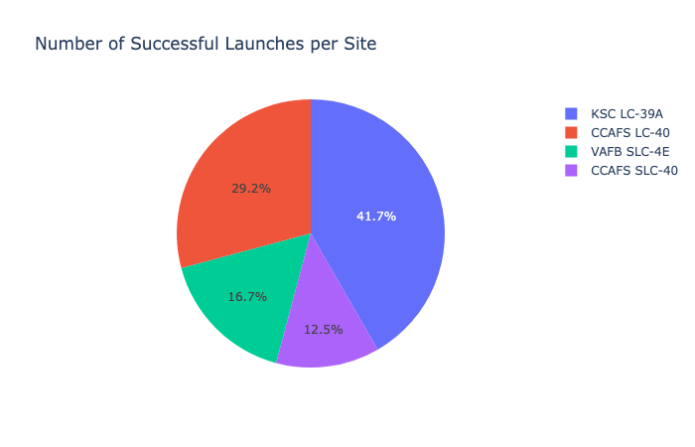
Number of Successful Launches per Site
The pie chart shows all the launch sites and their share of all the successful launches.
Each wedge represents a site and the percentage of successful launches from that site.
The legend indicates the colors associated with each launch site.
For example, site KSC LC-39A is blue and has the the largest share of successful launches with 41.7%.

Slide 40
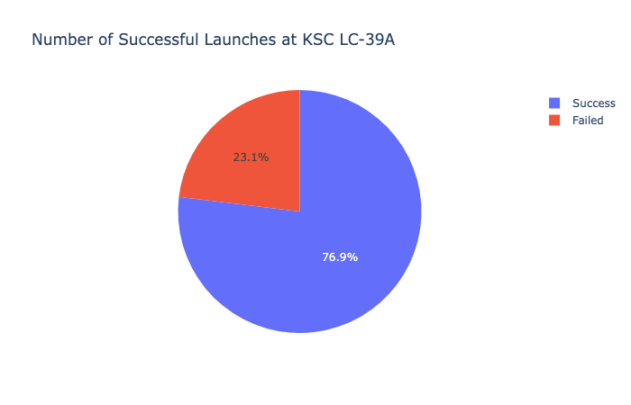
Pie Chart of the Site with the Highest Success
From the pie chart showing all launch sites, it was determined that KSC LC-39A had the most successful launches.
After selecting that site in the dropdown, the pie chart shows that 76.9% of launches had successful outcomes.

Slide 41
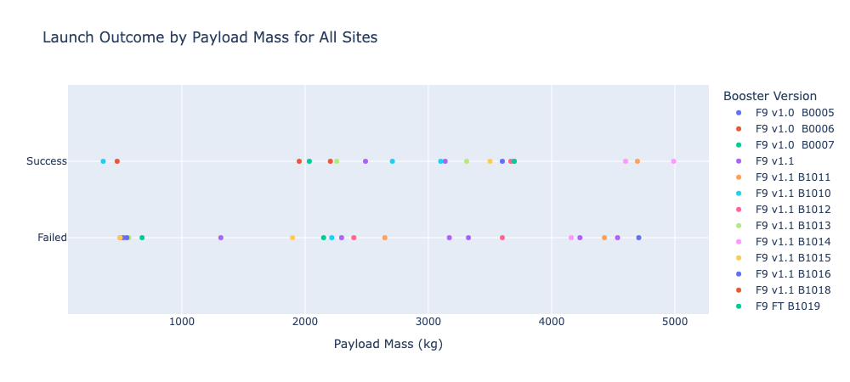
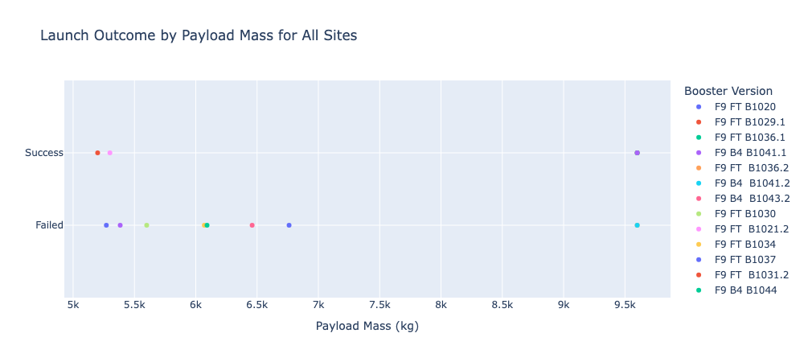
Scatter Plots of Payload vs. Launch Outcome
The scatter plot on the left shows the launch outcomes for payloads between 0 and 5,000 kg for all sites.
The scatter plot on the right shows the launch outcomes for payloads between 5,000 kg and 10,000 kg for all sites.
As the payload mass increases, there are more failed launch outcomes.

Slide 42

Section 5

Slide 43
Classification Accuracy
Different models were built using the following algorithms:
Logistic Regression (LR)
Decision Tree (DT)
Support Vector Machine (SVM)
K-Nearest Neighbor (KNN)
KNN, LR, and SVM produced nearly identical accuracy scores using both training and test data.
DT scored the best using training data and scored the same as the others using test data.
DT will be used to predict landing outcomes for future flights.

Slide 44
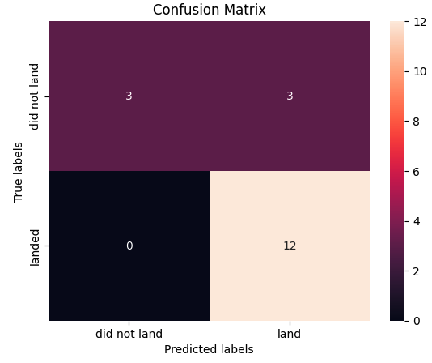
Confusion Matrix
A confusion matrix is a table that compares the predicted values against the true values. It displays the number of predictions that matched the true values as well as the number that did not.
The table is split into 4 quadrants.
Quadrant | Description
Upper left | True Negative = Model correctly predicted a failed landing
Lower left | False Negative = Model incorrectly predicted a failed landing
Upper right | False Positive = Model incorrectly predicted a successful landing
Lower right | True Positive = Model correctly predicted a success landing
A Negative outcome means the rocket failed to land.
A Positive outcome means the rocket landed successfully.
For the two upper quadrants, there were 6 records where the flight failed to land. The Decision Tree correctly predicted that 3 would fail to land but determined that 3 would succeed, when in fact they also failed.
For the two lower quadrants, there were 12 records where the flight landed successfully. The Decision Tree algorithm correctly predict all 12.
Confusion Matrix for the Decision Tree Algorithm

Slide 45
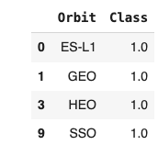
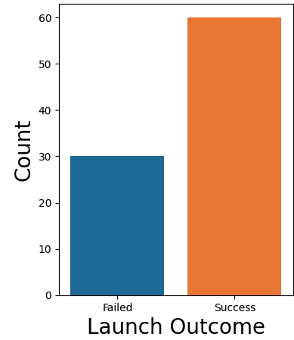
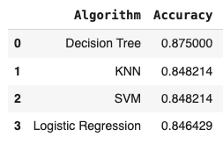
Conclusions
The success rate for landing is 66.7% or 2 out of every 3 flights will land successfully.
The four orbit types with the highest success rates were ES-L1, GEO, HEO, and SSO.
Decision Tree Algorithm is the best model to use for predicting the landing outcome of future flights with an accuracy rate of 87.5%.
Launch site KSC LC-39A had the best mission success rate at 76.9%.

Slide 46
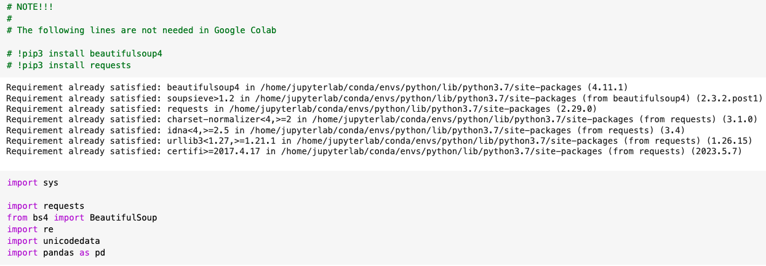
Appendix
Google Colab did not require installing some libraries. There were installed already.

Slide 47
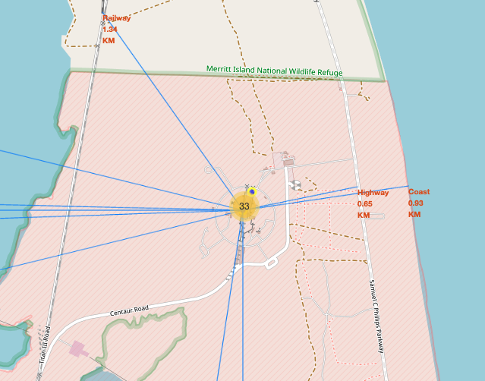
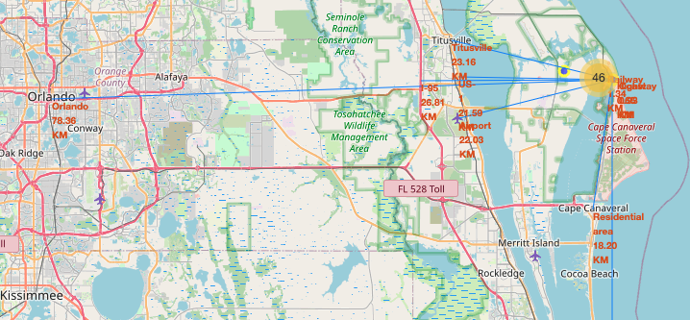
Appendix
Here is a proximity map for CCAFS LC-40.

Slide 48
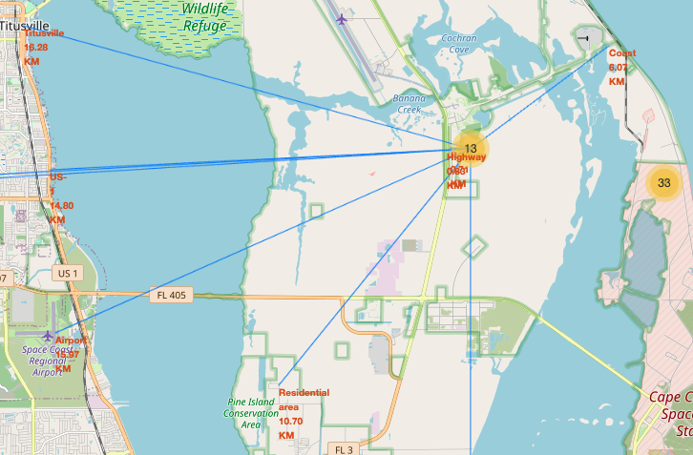
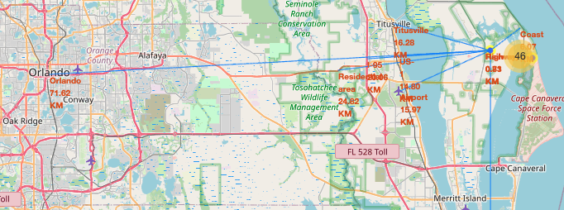
Appendix
Here is another for KSC LC-39A.

Slide 49
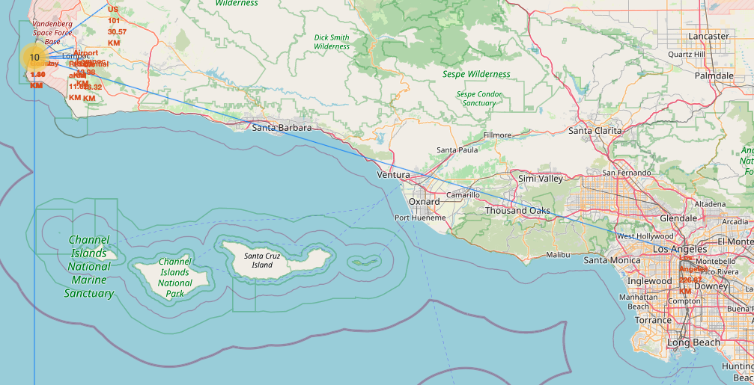
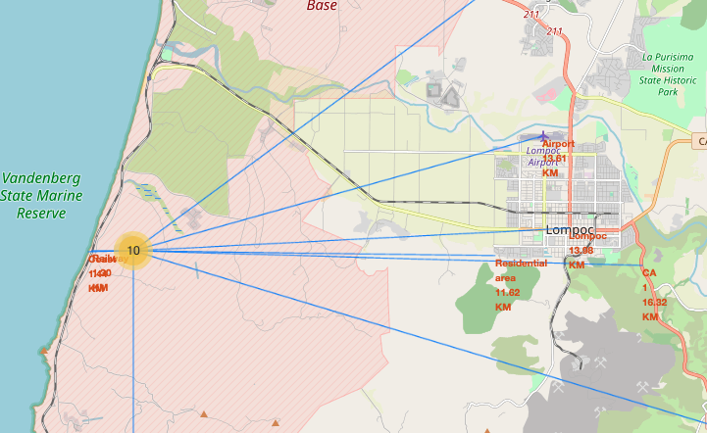
Appendix
Here is another for VAFB SLC-4E.

Slide 50


